Slide 1


Employer MyBenefits Portal Tutorial
NEW HIRE- Basic Life Only (Single Entry)

Slide 2
Before You Begin
2 of 11
Helpful Tip
Gather all employee information before starting. Having everything ready will make the upload process faster and help prevent errors.
Before adding employees to Basic Life coverage, please review the following information:
New Hire – Basic Life transactions can be entered any time during the year.
Coverage is effective the first day of the month following the employee's hire date and should coincide with payroll deductions.
Retroactive effective dates cannot be entered online.
Complete one transaction at a time.

Slide 3
Before You Begin
3 of 11
Helpful Tip
Bookmark the Employer Portal login page for quicker access in the future.
You must be logged into the NMPSIA MyBenefits Portal before
completing this tutorial.
If you are a new user, forgot your password, or experience login issues, please refer to the Employee Login Tutorial https://nmpsia.com/employer-trainings.html for complete step-by-step instructions.
Important Reminders
• MFA codes expire after 5 minutes.
• Use the email associated with your NMPSIA benefits.
• Check your Spam or Junk folder if you do not receive your code.
Need help logging in?
Please refer to the Employer Login Tutorial before continuing.
The Employer Login Tutorial includes:
✔ First-Time Login
✔ Password Assistance
✔ MFA Verification
✔ Common Login Errors
✔ Account Assistance
Go to NMPSIA.com
↓
Benefits Portal Login
↓
Select Employer
↓
Enter District ID
↓
Select Representative
↓
Enter Password
↓
Complete MFA Verification

Slide 4
What You'll Need
4 of 11
Helpful Tip
Verify you have all information before beginning.
Before beginning, have the following information available:
District ID
Your login credentials
Access to your authentication email
Employee Demographics
Employee Salary, Hire Date, Job Title, and Number of Hours

Slide 5
Transaction Overview
5 of 11
Helpful Tip
Every Employer Portal transaction follows the same basic process:
→ Enter → Review → Submit → Verify
Although each transaction may require different information, the overall process remains consistent throughout the Employer Portal.
This tutorial will show you how to:
Enter all required employee information
Review the transaction for accuracy
Submit the transaction for processing
Verify that the transaction was successfully submitted
Understand what happens after submission

Slide 6
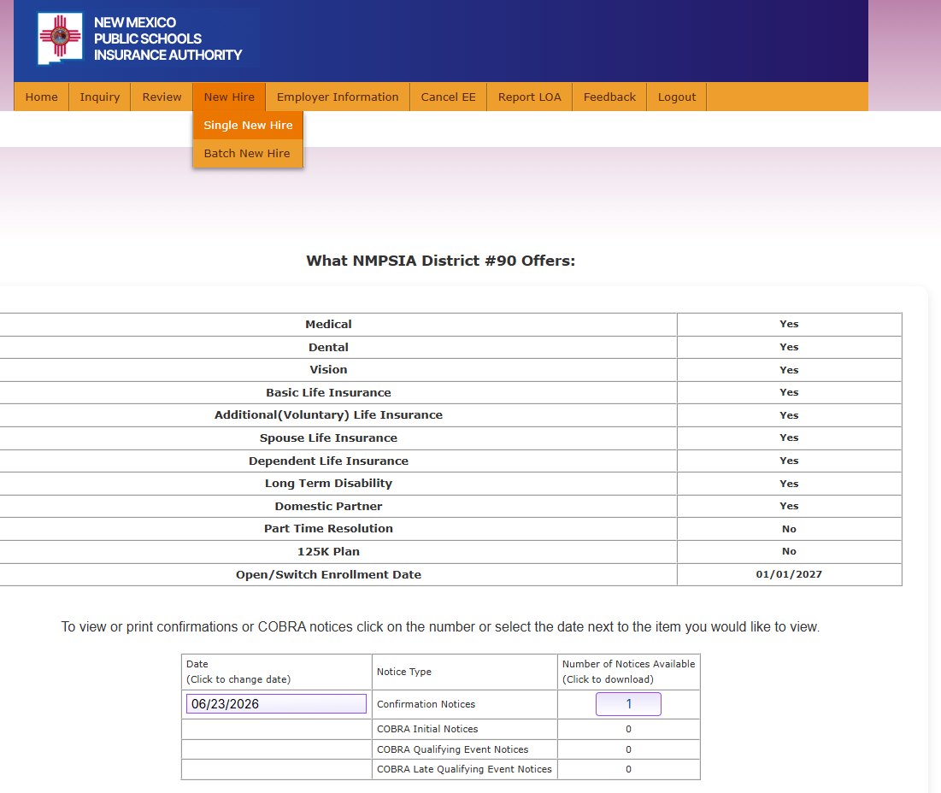
Step 1
6 of 11
From the Home page
Navigate to the New Hire tab.
Choose Single New Hire.

Slide 7
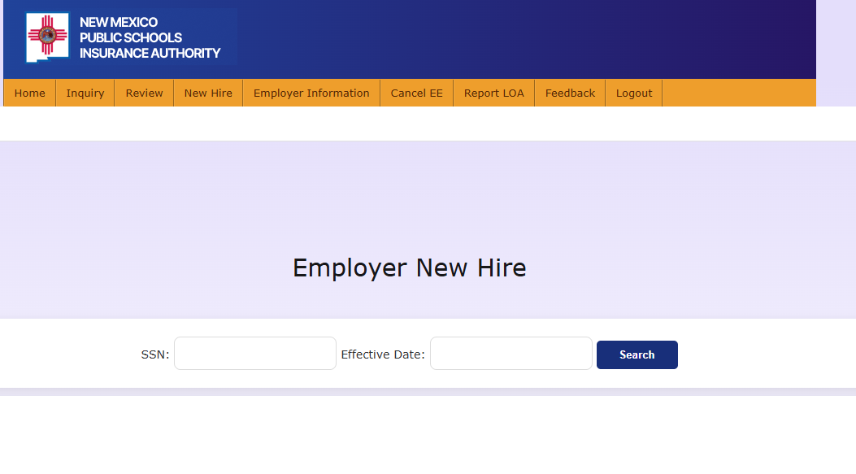
Step 2
7 of 11
Enter the employee’s Social Security Number (SSN).
Enter Basic Life Effective Date.
Select Search.
Helpful Tip
Effective date must be the first of the following month from date of hire.
3
1
2

Slide 8
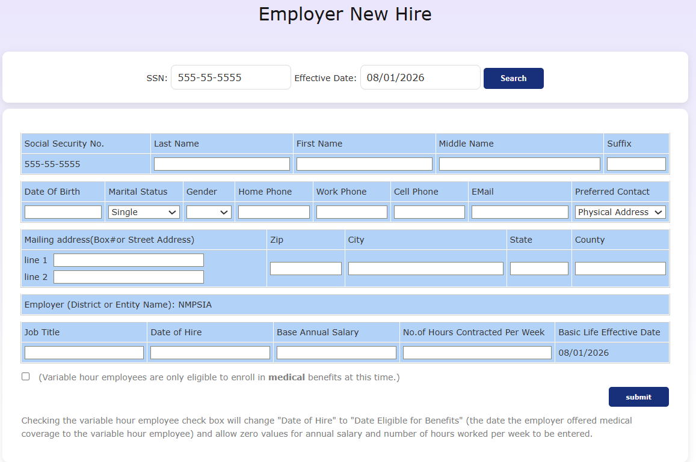
Step 3
8 of 11
Enter employee information. Make sure to complete all required fields.
Select Submit.
1
Helpful Tip
Review all information is correct before submitting.
2

Slide 9
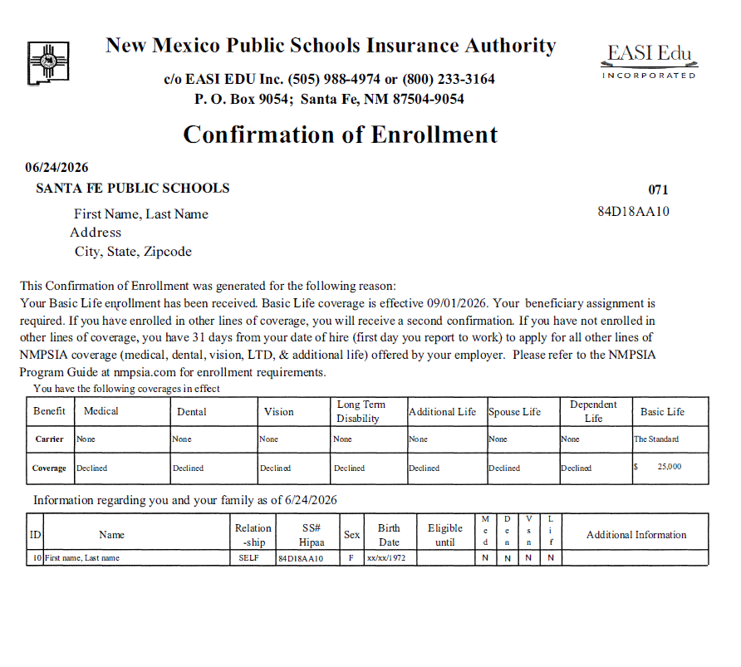
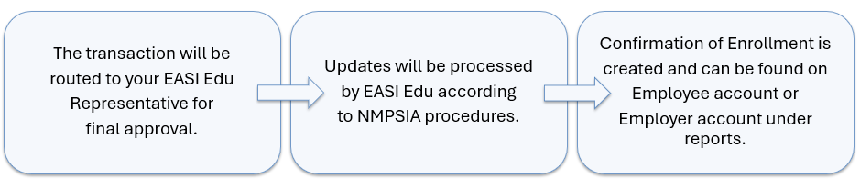
After Submission
9 of 11
Helpful Tip
Verify all information is correct, distribute to employee or print for employee file if needed.

Slide 10
Common Errors
10 of 11
Helpful Tip
If an error continues, contact your EASI Edu Administrative Representative.
Invalid Effective Date – Verify the effective date is correct and meets NMPSIA eligibility requirements before submitting the transaction.
Authentication code expired – Request a new Multi-Factor Authentication (MFA) code and sign in again.
Session timed out – Log back into the Employer Portal and restart your request.
Missing Required Information – Make sure all required fields are complete.

Slide 11
Need Assistance
11 of 11
Thank you for supporting your employees!
Contact Us:
EASI Edu
Phone: 1-800-233-3164
Contact your assigned representative for portal assistance.
Or
NMPSIA Benefits Team
Phone: 1-800-548-3724

